Slide 1



STUDIO SHODWE
Water Level Monitoring System
Team AutoBots
page 01
Submitted to:
Mr. Nasir Mehmood

Slide 2



STUDIO SHODWE
Group Members
page 02
Maryam Sameen 22-NTU-CS-1354
Muhammad Kaif 22-NTU-CS-1364
Muhammad Abdullah 22-NTU-CS-1358

Slide 3
Project
STUDIO SHODWE
Overview
Objective:
To design an IoT based system to monitor water levels in a tank using an ultrasonic sensor and automate motor control with alerts and real-time ML prediction.
Key Features:
Real-time water level monitoring using ESP32-S3
OLED Display for current tank status, buzzer status, prediction
Motor ON/OFF based on Water level
Buzzer for refill/full alert
ML Model for predicting usage patterns and level status
page 03

Slide 4


Core
Technologies
Esp32 for Brain
Ultrasonic Sensor (Eyes for water)
Relay + Pump (under consideration)
OLED Display
LED + Buzzer for alerts
Hardware
page 04
Influxdb for real time values
Grafana for Dashboard
Arduino IDE
Python
Software
A
Manually through push button
Automatically using Relay
Control Options

Slide 5
Software Implementation
page 02
Arduino IDE for firmware development
Sensor Logic: Calculates level using HC-SR04 sensor
Display Logic: Updates OLED in real time
Relay Logic:
Motor ON if level < 10%
Motor OFF if level > 90%
InfluxDB and Grafana Integration: Sends timestamped readings on InfluxDB then Grafana for visualization

Slide 6
Machine Learning
Integration
Used AI on edge to predict water usage trends and optimize water control
Steps:
Dataset Preparation:
Collected historical water level readings and corresponding usage categories(e.g., low, medium, high)
Model Training
Features: Timestamp, Hour,Day,Current level
Classifier: Random Forest or SVM
Output: Status
Model Conversion:
Trained model converted to .tflite format, further encoded as C header for microcontroller
Deployment on ESP32:
Model inference run locally using Tensorflow Lite
Real time prediction without cloud involvement
page 03

Slide 7

How it
Works in real life
You get notifications and can override the system – right from alerts
Imagine a tank that knows “When to fill itself”
No guesswork. No overflows
page 05

Slide 8
Where it
can be used
Homes
No more overflow/
Dry tanks.
Industry
Smart resource planning
Farms
Timely irrigation
Buildings
Multi-tank
management
page 05

Slide 9
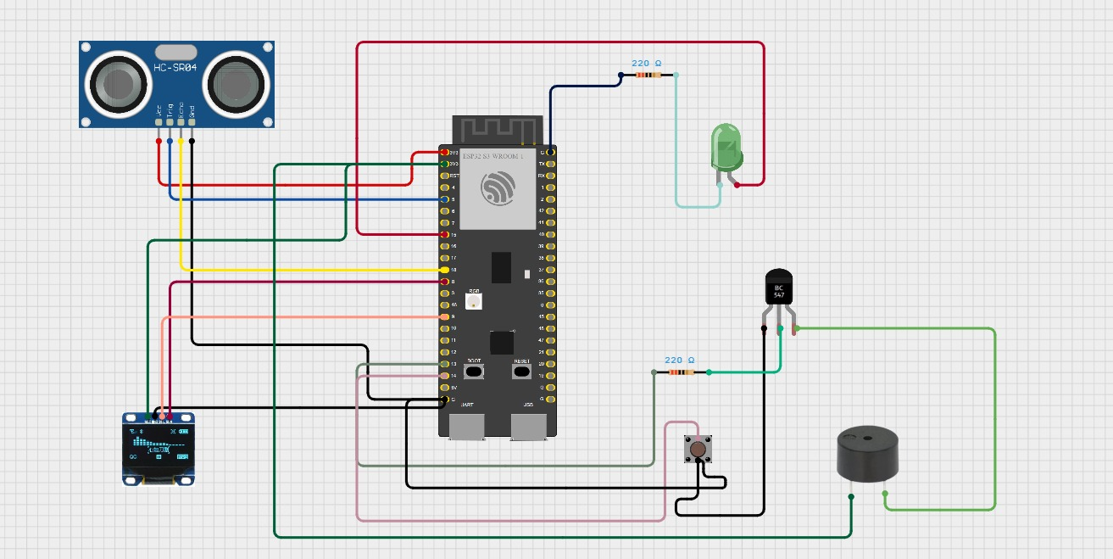
Circuit Diagram
page 08

Slide 10
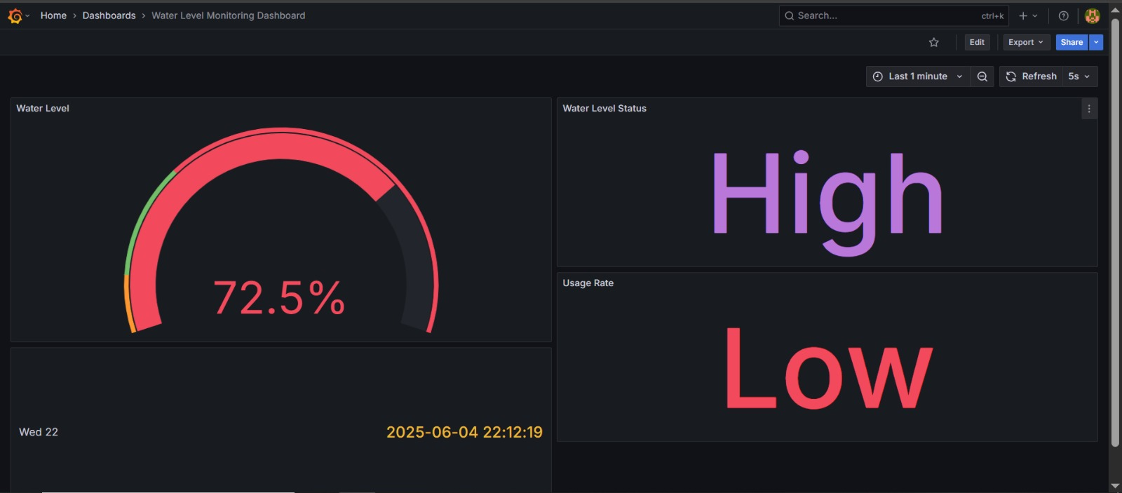
How will it look like
page 08

Slide 11
Sustainable
Impact
Cuts Electricity Costs
Automation in routine tasks
IOT in smart cities
Saves Water

Slide 12
Future
Prospects
Mobile App
Leakage Detection
Multi-Tank
Real Time tank status on the go
Manual Pump Control via app interface
Can be performed using anomaly detection ML models
Manage multiple tanks and pipelines
Detect leaks or abnormal consumptions

Slide 13


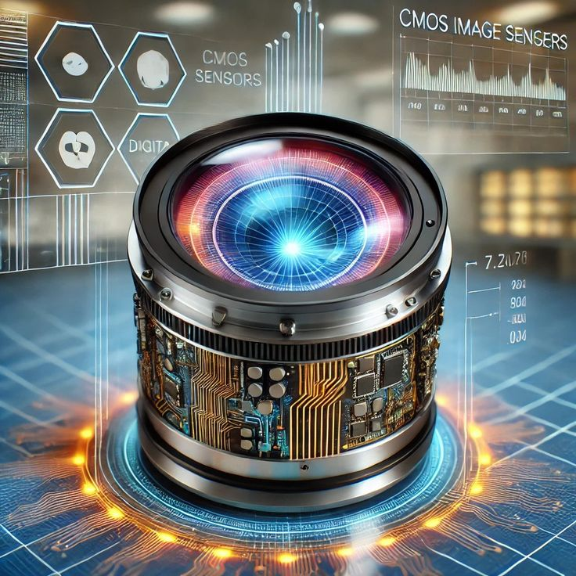
Possible Challenges
Ahead
Hardware integration
Connectivity issues
Sensor accuracy
Compatibility issues between ESP32 and sensors.
Power supply fluctuations affecting stability.
Dependencies on
Wi-fi for cloud updates may result in delays or data loss.
Ultrasonic sensors may give inconsistent readings in narrow or turbulent tanks.

Slide 14
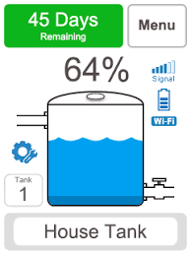
Conclusion
We developed a smart, automated water level monitoring system using IoT. The system ensures efficient water usage, reduces manual effort, and prevent wastage. With real-time data and cloud sync, it brings intelligence to everyday resource management. It is scalable, customizable and impactful – a step towards sustainable smart living.

Slide 15
THANK YOU!
page 15

